Slide 1

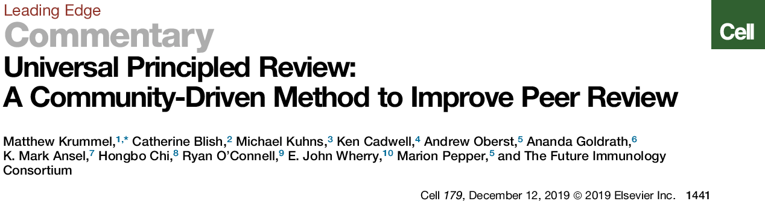
The Practice of Peer Review
Possible Key Document for this discussion (click to open entire document)
Originally assembled and edited by Matthew Krummel Catherine Blish, Michael Kuhns, Ken Cadwell, Andrew Oberst, Ananda Goldrath, K. Mark Ansel, Hongbo Chi, Ryan O’Connell, E. John Wherry, Marion Pepper

Slide 2
Principles of Peer Review—For Users
To modify this document and ’make it your own’, click on ‘View’ and ‘Master’ and modify the master slide to place your favorite logo in place of the ImmunoX and UCSF one.
If you make substantial modifications and want to share your version, please visit the Github page for UP Review here.
Highlighted text is meant to be a stopping point where the class/group could first be queried as to their opinions. Use a white board to get thoughts from the room and compare to the subsequent bullet points. Add more if you like.

Slide 3
Goals
Discuss Current and Teach Best Practices in Peer Review.
Consider Peer Review in Context. How do we read/review papers and why do we offer criticism?
Talk about current and best practices for reviewing and how reviewers, editors and authors should all align on these. Open Forum
Talk about how one might navigate the process, as an author. Open Forum. Examples of decision→ approach→ decision.
Talk about how our field should/could practice this important part of our research life.

Slide 4
Overview
A brief introduction to the various goals of publishing and their alignments. Consideration of human psychology.
The ”good” goals of peer review.
The un-desirable facets of peer-review.
The Results of ‘Traditional’ Peer Review.
One (partial?) solution set. Universal Principled Review v1.
Templated QC and distinct ‘Impact’ scoring.
Community-definitions of ‘bad behaviors’ and how to call them out and act on them (for authors, editors, reviewers).
Unlinking the reptilian brain?
Reviewing in the next generation and the impacts of technology/publication changes.
Pre-publication and post-’publication’ peer review

Slide 5
A Primer to the Playing Field
Peer Review Takes Place Against a Backdrop of the Publishing Industry.
This industry has served us to help prioritize and categorize (curate) science.
Their goals include providing us with curation both:
to a known level (here, scientists interests are aligned since we like to know where to look for high quality—this is helpful)
to the highest level
Increasing their ‘impact’ serves their ‘business interests’ which are not necessarily aligned with ours.
More impact=more subscriptions=more advertising revenue.
Scientists
(Producers)
Journal
(Curators)
Advertisers
Content
$
(α ‘Impact’)
$$$
Scientists
(Reviewers)
(α ‘Impact’)
Scientists
(Subscribers)
Opinions
(Peer-Review)
See also: https://www.slideshare.net/StephanieDawson1/publishing-berlin-25thesc140917short and Publishing and Sneetches
Notes:
Many people recently have noticed that scientist pay for the value of their work…

Slide 6
Definitions: Quality and two kinds of Impact
Quality. Are experiments done well? Can I interpret this etc. Does it help the field to work out a problem? Is it a stable stepping-stone in a path across a thick marsh?
Actual Impact (your paper actually moves the field)
Perceived Impact (your paper shows up in ‘Big’ journal, with big ’impact factor’, people read it and even cite it because it becomes in fashion.)
How are these things related? Which ones can be assessed by review?

Slide 7
Quality and the Two Kinds of Impact
Quality. Are experiments done well? Can I interpret this etc. Does it help the field to work out a problem? Is it a stable stepping-stone in a path across a thick marsh?
Actual Impact (your paper actually moves the field)
Perceived Impact (your paper shows up in ‘Big’ journal, with big ’impact factor’, people read it and even cite it because it becomes in fashion.)
How are these things related? Which ones can be assessed by review?
Quality is (nearly) an absolute requirement for Actual Impact.
When judging very new data we can only have opinions of Perceived Impact:
+ Perceived Impact may only have modest requirements for Quality. (i.e. rushed papers that aren’t really what we think)
Long-term we can possibly assess Actual Impact.
Prediction of ‘Actual Impact’ is often subjective /difficult.

Slide 8
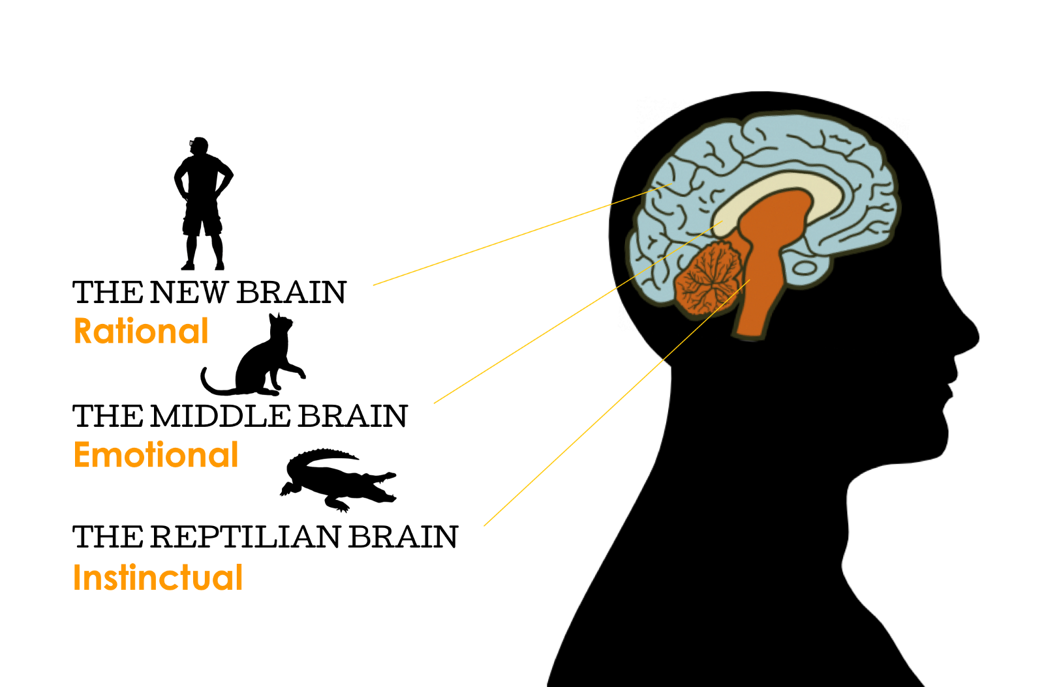
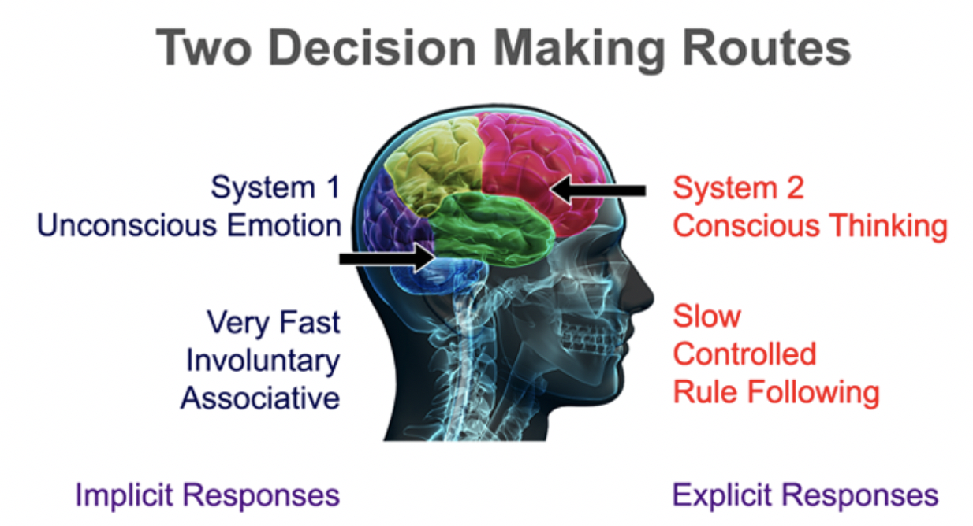
We (People) Are Reviewers
Consider that Reviewers (us) are human. Consider the Triune Brain Hypothesis: Immediate emotional responses can serve as the source for later ‘rational’ decisions.
https://hackernoon.com/its-completely-irrational-to-think-decision-making-is-rational-2fabe48dfb4c
https://brainhealthnorthwest.com/why-do-i-keep-making-bad-decisions/
It’s likely that most of us have an emotional response to:
a paper,
the author,
the topic and its overlap with our work,
its writing style, font, layout of figures,
before (or in addition to) writing our assessments of the merit of a paper.

Slide 9
Possible Sources of Emotional Responses to a Paper
Fear:
Reviewers may fear that a new set of data will ruin the meaning of their work or field by explaining things they missed, or by bringing a (better?) viewpoint.
They may fear that a new set of data will be the new bright shiny thing and make them (and their lab) obsolete.
Anger/Hurt
They may be angry/hurt that someone isn’t giving them credit for their work or isn’t giving a valued colleague credit for their work.
They may be angry/hurt that reading this paper is ‘wasting’ their time, particularly when it’s a beautiful day and others around are having fun but they are stuck inside with a paper full of spelling-mistakes.
They may be jealous or angry at you for a previous personal slight: at a meeting, in a bar…
Competitiveness? (Aggression?)
When Horses run on the track, some horses seek to will run faster when another horse is sprinting ahead (‘spirit’). Some reviewers appear to want to run alongside your work, intellectually, and then sprint ahead. The excitement of your work can make them want to ‘prove’ their intelligence, by suggesting more and more experiments.
Notes:
These are amateur opinions of why we get/give bad reviews.

Slide 10
Value of Peer Review
Using the White Board, what is the value added by having outside readers vet scientific works?

Slide 11
Value of Peer Review
Using the White Board, what is the value added by having outside readers vet scientific works?
Additional ‘Eyes’ on the data.
Help identify technical issues that lead to mistaken conclusions
Ensures that field-specific standards are applied (e.g., the performance and reporting of replicate experiments and application of statistical tests)
Broadly: QC to minimize time wasted by the field, following experiments that are not high-quality or ideas that are poorly supported.
Add additional interpretations of the data to provide alternatives and ‘balance’.
Helping to prioritize the work we read. Reading every paper every week would be paralyzing. We rely on expert opinions of the community about the merit of a work, to help us prioritize our time, in our field.
Which one(s) of these are most subjective?

Slide 12
An Irony (?) About the ‘Best’ Journals
We think that the ‘best’ journals deserve our best papers.
We send our top work to them.
They often have the slowest review process, thinking that they are protecting their brand.
→The work we consider ‘best’ takes the longest to publish. This is clearly a serious problem and their lack of investment in streamlining is egregious, given profits.
Ergo: High-impact journals are likely to remain so without them doing much work. It is likely at least partially self-fulfilling that they have high impact—we only send them our best works and relegate the rest elsewhere, even before review.

Slide 13
Undesirable Outcomes of Peer Review
White Board some of the less-desirable consequences?

Slide 14
Undesirable Uses of Peer Review
White Board some of the less-desirable consequences?
Sandbagging the competition by proposing a ton of new experiments.
Some reviewers may hold back other’s work to give them time to ’catch up’.
Some reviewers may believe that non-standard ideas or approaches do not ‘deserve’ consideration.
Protecting the Field. (Keeping ideas that disagree with dogma in lower journals).
Reviewers feel that an idea that is contrary to their favorite ones.
Sometimes the ideas are indeed currently poorly constructed/supported.
Judging the Impact from a very high seat (playing the part of ‘God’ or ‘A really smart person’
Only some papers can be considered impactful. If you award this one with that stamp of approval, others must lose (the zero sum-game of fashion).
‘Smart’ people like to think ‘I could have thought of this idea’ even if they never did nor ever proved it. A proliferation of review journals increases the odds that a lot of ‘new’ ideas have already been partially conceived. (Nevertheless, we should make no mistake that nothing beats data and experiments).
All of these slow down science.

Slide 15
The Traditional Peer Review Format
Opening Paragraph—summarize the paper and its key findings. Generally conclude with a statement about whether it should get in to the journal where it was submitted. (Sometimes akin to either a ‘Love Letter’ or a ‘Dear John’ letter.)
Major Comments
These are typically meant to be ‘must do’ to achieve a bar for the journal
Minor Comments
These are typically meant to be ‘smaller’ things like spelling mistakes or mislabeled figures.
There are no hard/firm rules about the above. Objective ”QC” critiques mingle with Subjective “Impact” ones, quite interchangeably most times.

Slide 16
How to Address (Poor) Peer Review
Get angry. Call Editor in Rage (not advised). Voodoo.
(Drink.)
Reflect on what is reasonable/not. Wait at least 24 hours.
(Drink.). Make a plan for revision—for this journal or another.
Contact editor to discuss a plan. A good editor would/should negate bad commentary and should be willing to engage if you are rational.
Revise/Resubmit or Go to another journal (lower, same or higher “level”).
If Discussing this topic as a community, this is a place to share types of issues and solutions
If anyone has text from actual reviews to share, that could be useful (they are anonymous, afterall!)

Slide 17
Plan Ahead for Peer Review?
Before You Submit
Getting Editor/Field Attention, in Advance. Phone calls, present at meetings.
Presubmission?
Cover letter.
Look/tone of the MS, given the field/reviewers.
Should you contact journal every so often to discourage stalling?
Once you get reviews back:
Plan for the initial shock.
Know you will need to make some changes.
Use the Editor.
Moving On.
This should be OpenForum. Share Examples of Reviews,
how you responded,
what happened,
what you learned.

Slide 18
Difficulties in Addressing Problems
What could go wrong?
Notes:
If Discussing this topic as a community, this is a place to share types of issues and solutions
If anyone has text from actual reviews to share, that could be useful (they are anonymous, afterall!

Slide 19
Difficulties in Addressing Problems
What could go wrong?
Editors are too busy/ non-responsive.
Editors have too little spine to oppose ‘famous’ reviewers’ opinions, even when those famous reviewers are being unreasonable.
The single ‘reviewer 3’ who holds a paper up (odds are that 1 out of 3 reviewers will be irrational.
The sum of the comments from 3 reviewers is far too high to address in a lifetime (there is no consensus).
The paper is high quality but you placed it ‘too high’ and Reviewers are unwilling to give you the nod for impact…
In the current system, reviews are only ‘portable’ within a publisher (e.g. Nature to Nature Immunology).

Slide 20
How to Address Defects in this System.
Rules for Reviewing to encourage or separate non-emotional comments? “Universal Principled (UP) Review” v1 (Collection of Peers, original drafters of this deck). Also, provide exemplars of NoNos (bad behaviors) for the community (and editors) to recognize/police. Intended to be usable cross-journal. Aimed at decreasing sand-bags.
Peerage of Science. https://www.peerageofscience.org/ as a peer-operated service for reviewing—would be cross-journal. Seeks to have reviewers self-select.
eLife is seeking to get reviewers to agree on ‘consensus’.
More radical re-envisioning of Publication Industry? Engagement of PubMed to provide post—publication review options?

Slide 21
The UP Review Positive Template
How to divorce reptilian responses from carefully-considered ones.
UP proposes to template yourself to look for what is most important (a template helps—we took a variation of what the NIH introduced for study section peer-review which has merits (but still, yes, can be abused).
UP proposes to try to help differentiate and separately (transparently, objectively) score the must-haves of data Quality along with the more subjective impression of the Impact of the work.

Slide 22
UP Review Positive Template Proposal
Quality Considerations
Experiments
Completeness
Reproducibility
Scholarship
Typically a 3-point scale (1: v good, 2:marginal, 3:unacceptable)
Same for any journal. ‘Objective’.
Impact Considerations
Novelty/Fundamental and Broad Interest
Extensibility
Typically a 4-point scale (1: CNS level journals, 2:Field-specific (e.g. Nat. Immunol), 3: Field-specific catch-all (e.g. JI), 4: Nowhere. ‘Subjective’.

Slide 23
Quality
Quality: Experiments 1-3 scale addressing the following:
● Figure by Figure, do experiments, as performed, have the proper controls?
● Are specific analyses performed using methods that are consistent with answering the specific question?
● Is there the appropriate technical expertise in the collection and analysis of data presented?
● Do analyses use the best possible (most unambiguous) available methods, quantified via appropriate statistical comparisons?
● Are controls or experimental foundations consistent with established findings in the field? A review that raises concerns regarding inconsistency with widely reproduced observations should list at least 2 examples in the literature of such results. To address this question may occasionally require a supplemental figure that, for example, re-graphs multi-axis data from the primary figure using established axes or gating strategies to demonstrate how results in this paper line up with established understandings. It should not be necessary to defend exactly why these may be different from established truths, although doing so may increase the impact of the study and discussion of discrepancies is an important aspect of scholarship.

Slide 24
Quality
Quality: Completeness (1–3 scale)
Does the collection of experiments and associated analysis of data support the proposed title- and abstract-level conclusions? Typically, the major (title- or abstract-level) conclusions are expected to be supported by at least two experimental systems.
Are there experiments or analyses that have not been performed but if ‘‘true’’ would disprove the conclusion (sometimes considered a fatal flaw in the study)? In some cases, a reviewer may propose an alternative conclusion and abstract that is clearly defensible with the experiments as presented, and one solution to ‘‘completeness’’ here should always be to temper an abstract or remove a conclusion and to discuss this alternative in the discussion section.

Slide 25
Quality
Quality: Reproducibility (1–3 scale)
Figure by figure, were experiments repeated per a standard of 3 repeats or 5 mice per cohort, etc.?
Is there sufficient raw data presented to assess rigor of the analysis?
Are methods for experimentation and analysis adequately outlined to permit reproducibility?
If a ‘‘discovery’’ dataset is used, has a ‘‘validation’’ cohort been assessed and/or has the issue of false discovery been addressed?

Slide 26
Quality
Quality: Scholarship 1-4 scale, but generally not the basis for acceptance/rejection:
● Has the author cited and discussed the merits of the relevant data that would argue against their conclusion?
● Has the author cited and/or discussed the important works that are consistent with their conclusion and which a reader should be especially familiar when considering the work?
● Specific (helpful) comments on grammar/diction, paper structure or data presentation (e.g. change a graph style or color scheme) go in this section, but scores in this area not to be significant bases for decisions.

Slide 27
More on Scholarship
In the long-term, we all acknowledge that this is quite an important part of what gets work to be read. It is here that you tell the history of the field (so, where authors being accurate and appropriately inclusive). This is where proper citation/attribution actually plays a role—putting your work into good perspective, largely to minimize a reptilian response but also to accurately draw attention to the proposed Actual Impact.
Scholarship also means readability. Although the data of a paper whose mastery of English is poor is ‘just as good’ as other data done in perfect English, having a manuscript be easily readable does matter for consumption of your idea.
Importantly, Scholarship and Scientific Quality are not synonymous. The latter would seem a more critical role than the former, There is no denying that a journal, in particular one that is at the top of its field, should ideally be able to help manage the former such that it optimizes readership and acceptance (Actual Impact) of a paper.

Slide 28
Impact
Impact: Novelty/Fundamental and Broad Interest 1-4 scale addressing the following:
● A score here should be accompanied by a statement delineating the most interesting/important conceptual finding(s), as they stand right now with the current scope of the paper. A ‘1’ would be expected to be understood for the importance by a layperson but would also be of top interest (will have lasting impact) on the field.
● How big of an advance would you consider the findings to be if fully supported but not extended? It would be appropriate to cite literature to provide context for evaluating the advance. However, great care must be taken to avoid exaggerating what is known comparing these findings to the current dogma (see Table 2). Citations (figure by figure) are essential here.

Slide 29
Impact
Impact: Extensibility 1-4 or N/A scale, addressing the following:
● Has an initial result (e.g. of a paradigm in a cell line) been extended to be shown (or implicated) to be important in a bigger scheme (e.g. in animals, or in a human cohort)?
● This criterion is only valuable as a scoring parameter if it is present, indicated by the N/A option if it simply doesn’t apply. The extent to which this is necessary for a result to be considered of value is important. It should be explicitly discussed by a reviewer why it would be required. What work (scope and expected time) and/or discussion would improve this score, and what would this improvement add to the conclusions of the study? Care should be taken to avoid casually suggesting experiments of great cost (e.g. ‘repeat a mouse-based experiment in humans’) and difficulty that merely confirm, but do not extend. (see Bad Behaviors, Table 2).

Slide 30
UP Review “NoNos”
Provide ourselves and our editors with templates of behaviors that are to be eliminated.
In so doing, provide avenues for neutralizing or reforming consistent reptiles and eliminating this from the reviewer pool.
Watch yourself for these—they have been with the field for a while, and likely we’ve been learning them from each other.

Slide 31
Up Review NoNos
● Blanket statements that lack justification (e.g. “I don’t believe the data”) indicate that the reviewer is not an active reader nor a careful judge. A review should call out concrete experiments, controls, etc. to address their issues. If a modification is needed to a method, a criticism should call out experiments to the degree that they can describe how they are achievable in a timely manner. A review should seek to pull meaning from the labors of others wherever possible.
● Claims of non-novelty based on papers that are non-synonymous, reviews, or cartoons (not primary data) are bases for eliminating a review or a score in that category. In particular, if a reviewer suggests that something is ‘known’ but no clear experiments that definitely show it have been performed, then their comment is false. Due to the proliferation of review articles and journals dedicated to reviews, many ideas may have been conceived but not experimentally demonstrated. The data needs to be shown and such experiments are very valuable. Further, the claims by a reviewer of ‘non-novelty’ or ‘known’ may not be shared by the broader community. It is fair for a reviewer to suggest that a review or primary article be cited and discussed (under Scholarship).

Slide 32
Up Review NoNos
● Critiques that compare current data against ‘ideas’ or ‘works of person X’ can suggest inappropriate bias. A paper and its data should be put up against 'data' from the past and not just 'ideas' or weighty individuals. Previous publications should have to be weighed for their data, while very carefully scrutinizing the source of momentum of a possibly incorrect or incomplete idea. The relevant Figure from previous studies (e.g “PubMedID XX Figure Y”) that seems to propose alternative conclusions should always be explicitly called out. The conclusions we hold dear from past papers might be based on data or experimental approaches that would not meet our current standards. We cannot rely on our recollection of our take-home message of an old paper. We have to go look at it and decide if we would reach the same conclusion, or if the interpretation an overreach or may be tempered given what is now known.

Slide 33
Up Review NoNos
● A reviewer who significantly confuses extensibility-level questions with quality and reproducibility and uses this as a primary reason for low scores in the ‘Quality’ categories should be eliminated. A good paper opens many new questions, but these new questions are often more appropriate for the next paper(s). When using the proposed guidelines, asking for further experiments (extending the result, possibly adding import) should be distinguished from assessing a feature that informs ‘Quality’, like the adequate repeat of an experiment. A reviewer should beware if they propose enough experiments for an entirely new (and entirely different paper). What does this paper show and does it support the fundamental idea of the publication, regardless of whether different experiments might also address that? Likewise, a reviewer should not delay publication of ‘mouse’ studies to demand data regarding human trials. Doing such significantly undervalues the value of basic science.

Slide 34
Up Review NoNos
● A reviewer who shows evidence that their ultimate satisfaction is the primary goal. This is most evidenced by a reviewer, following a response to their primary review, asking for new material or material that was not a direct consequence of a point raised in an initial review. Rather than increasing the value of science, this behavior mostly adds further burden in the whole process and delays science. Unless material evidence of fraud has emerged (or something equally onerous), reviewers should raise all major quality and impact issues in the first review. A general guideline should be for a reviewer to simply respond ‘Yes’ or ‘No’ as to whether an author’s increased discussion, modification of text or added experiment addresses the questions raised in a primary review.

Slide 35
A best condition is that reviews help quality experiments get seen and reasonable perspectives be advanced for public consumption.
Write reviews ‘as if you will sign your name to it’
Its OK to accept papers with minimal revisions if the experimental quality is there and interpretation
is defensible.

Slide 36
Publish First, Peer-Review Later?
A proposal for the future of scientific publishing in the life sciences. Stern BM and O'Shea EK. PLoS Biol 2019. PMID 30753179
“Although journals have their strengths, the traditional approach of selecting articles before publication ("curate first, publish second") forces a focus on "getting into the right journals," which can delay dissemination of scientific work, create opportunity costs for pushing science forward, and promote undesirable behaviors among scientists and the institutions that evaluate them. We believe that a "publish first, curate second" approach with the following features would be a strong alternative: authors decide when and what to publish; peer review reports are published, either anonymously or with attribution; and curation occurs after publication, incorporating community feedback and expert judgment to select articles for target audiences and to evaluate whether scientific work has stood the test of time.”

Slide 37
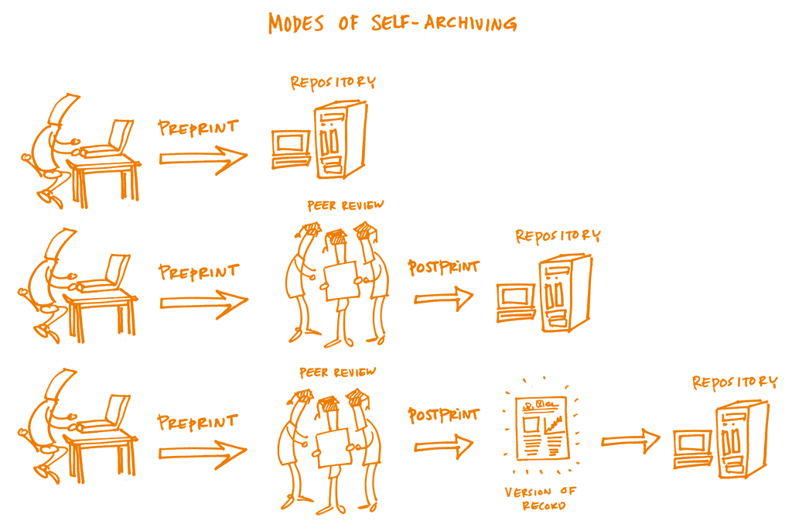
Variations on this already undeway with BioRXIV
There are clearly benefits and opportunities if we as scientists self-organize to ‘provide’ peer-review to ourselves, as an organized service. “Peerage of Science” appears as a first-try. Unclear if it will succeed without major support.
https://book.fosteropenscience.eu/en/Images/02%20Open%20Science%20Basics/02_open_access_archives.png

Slide 38
Peerage of Science?
How it works
Authors submit manuscript to Peerage of Science, before submitting to any journal. Submitting Author decides the deadlines for the four stages of the process, which are thereafter automatically enforced.
Once submitted, any qualified* non-affiliated** Peer can engage to review the manuscript.
Peer reviews are themselves peer reviewed, increasing and quantifying the quality of peer review.
The peer review process is available concurrently to all subscribing journals, with automated event tracking.
Authors may accept a direct publishing offer from subscribing journal, or choose to export the peer reviews to any journal of their choice.
*Has published a peer reviewed scientific article in an established international journal, as first or corresponding author. **Peers from the same institution, or who have co-authored articles with the authors within the last 3 years, are prohibited from engaging as reviewers.
Unclear if it will succeed without major support.

Slide 39
Should we petition PubMed to ‘Do More’?
● PubMed is ‘Our’ platform for papers. It would be a logical place for some improvements toward post-publication review.
● Why is there no way to place ‘tokens’ on published papers so as that more than three people can ‘vote up’ an exceptional paper or ‘fail to vote up’ a lesser one, regardless of the journal published? PubMed could be configured to do this. It could have features (and, yea, downsides) of Yelp.
● Relatedly, why can’t corresponding authors add modest ‘post-publication’ information to their papers, for public consumption? (It could be marked as non peer-reviewed). In short, we don’t publish paper copies anymore anyway—why do we still have historical restrictions of papers being ‘living manuscripts)

Slide 40
A best condition is that reviews help quality experiments get seen and reasonable perspectives be advanced for public consumption.
Write reviews ‘as if you will sign your name to it’

Slide 41
Contributors to this Perspective

Slide 42
Additional References
Kaelin, W.G., Jr. (2017). Publish houses of brick, not mansions of straw. Nature 545, 387.
NCB (2017). Principles of refereeing. Nat Cell Biol 19, 1005.
Ploegh, H. (2011). End the wasteful tyranny of reviewer experiments. Nature 472, 391.
Rubriq (2013). Peer Review: How We Found 15 Million Hours of Lost Time. AJE Scholar. https://www.aje.com/arc/peer-review-process-15-million-hours-lost-time/
Stern BM and O'Shea EK. A proposal for the future of scientific publishing in the life sciences. PLoS Biol 2019. PMID 30753179
Walter, P and Mullins D. On Publishing and the Sneetches: A Wake-up Call? https://www.ascb.org/publications-columns/presidents-column/on-publishing-and-the-sneetches-a-wake-up-call-november-december-2016-newsletter/

